Slide 1
Intro to Web Apps and Programming via Discord Bots

Slide 2
Today’s Topics
Info
Introductions (of people)
High level conceptual explanation
Programming
Build basic bots
Examine Code
Add 1 extension – learn by doing!
Discuss other extensions/uses
Free time to build
Link to Slides (also at end):

Slide 3
Introductions (of people)
Me
Name: Emily or M
Majors: Japanese & Computer Science (class of 2017)
Discord chatbots are an occasional hobby ☺
Favorite fruit: strawberries
You
Name?
What do you know about Discord chatbots?
Favorite fruit?

Slide 4
The Internet
Notes:
http://www.submarinecablemap.com/

Slide 5
Client-Server Model
Notes:
https://en.wikipedia.org/wiki/Client%E2%80%93server_model

Slide 6
APIs
Application Programming Interface
set of clearly defined methods of communication between various software components
Discord’s API
Official: http://discordapi.com/
Unofficial: https://discordapi.com/unofficial/comparison.html
Notes:
https://en.wikipedia.org/wiki/Api

Slide 7
Discord.js
https://discord.js.org/
https://github.com/hydrabolt/discord.js
Is a “Node Package” – what?

Slide 8
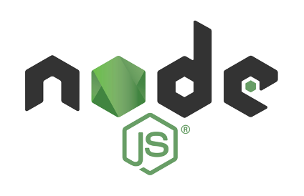
Node.js
https://nodejs.org/en/
Node.js: “JavaScript runtime built on Chrome's V8 JavaScript engine”
a program that runs your code
npm: Node Package Manager

Slide 9
Practical Summary
Discord bots are clients that connect to Discord servers
Make a bot = make a client = make a program
Node.js runs our program
Discord.js makes internet connections + Discord API easy

Slide 10
Ok, let’s BUILD!
(Yay!!)

Slide 11
Part 0: Accounts Setup
Discord Account:
https://discordapp.com/
Codeanywhere Account:
https://codeanywhere.com/
Notes:
passwordtoostrong4u? ☺

Slide 12
Part 1: Client Setup
https://codeanywhere.com/
Create container
“Node.js” “Centos 6.5”

Slide 13
Part 1: Client Setup
$mkdir bot (make a directory)
$cd bot (navigate to directory)
$nvm install 6.9.4 (change node version)
$npm init (initialize node package manager)
$npm install --save discord.js (install node package)
create “index.js” in bot folder
copy-paste from https://discord.js.org/
Notes:
more command prompt-like console commands:
http://mally.stanford.edu/~sr/computing/basic-unix.html

Slide 14
Part 2: Discord Server Setup
https://discordapi.com/ -> My Apps
Tell Discord to listen
Name the app
Create a Bot User
Copy bot’s API token into index.js

Slide 15
Part 3: Running the bot
Discord: create new server
Get URL: https://discordapi.com/permissions.html
Run the bot: $node index.js
In Discord chat, type “ping”

Slide 16
CONGRATULATIONS! YOU HAVE A WORKING DISCORD CHAT BOT!

Slide 17
Javascript Crash Course
Heeere we go!

Slide 18
Javascript syntax
Variables
Primitives
Functions
Objects
Code Flow
If statements
Events

Slide 19
Variables
var myVariable;
?

Slide 20
Primitives
var myVariable = 3;
var contents = “hello there”;
var JavascriptIsCool = true;

Slide 21
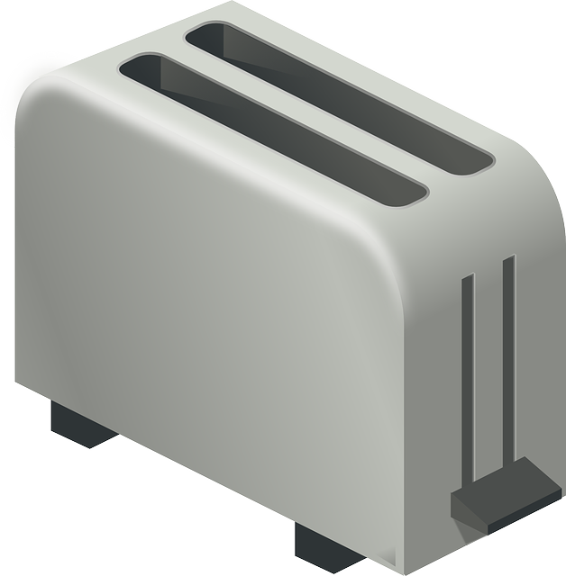
Functions
var myFunction = (arg1, arg2) => {
//do stuff with arguments arg1, arg2
return answer; //optional
}
myFunction(“hello”, 45);
Notes:
// is a comment

Slide 22
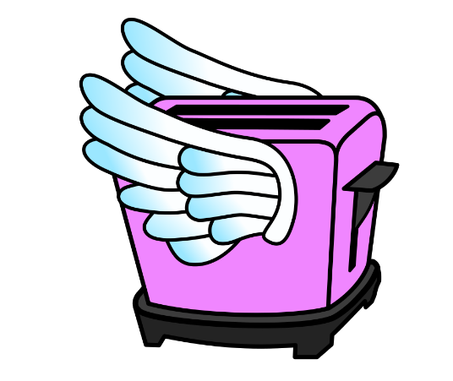
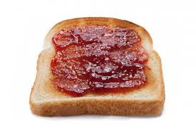
Functions can use functions!
var myFunction = (arg, yourFunction)=>{
//do stuff
yourFunction();
}
Notes:
// is a comment

Slide 23
Objects
var myObject = new Object();
const Discord = require(“discord.js”);
Notes:
We won’t be making objects!

Slide 24
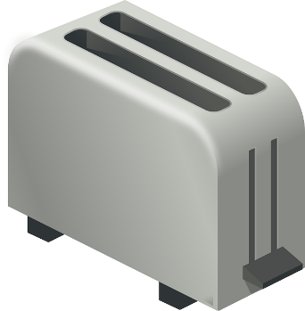
Objects can have anything!
message.content // “hi!”
msg.author.name
msg.reply(“hey!”)
Properties
Methods

Slide 25
Objects can be groups of variables
var MyCollection = get_collection();
MyCollection.find(“username”, “Bob”);
var MyArray = get_array();
var temp = MyArray[0];
//like MyArray.get(first)
https://developer.mozilla.org/en-US/docs/Web/JavaScript/Reference/Global_Objects/Array
https://discord.js.org/#/docs/main/stable/class/Collection?scrollTo=array

Slide 26
Code Flow
var do_math = (fxn, number1, number2) => {
return fxn(number1, number2);
};
var multiply = (a, b) => { return a*b; };
var x = 3;
var y = 2;
console.log(do_math(multiply,x,y));
Variable Types: Primitive, Function, Object
Notes:
We won’t be making objects!

Slide 27
If statements
if(/* true */){
//do things
}
else if (/* true */) {
//do things
}
else {
//do things
}
//do more things
2-1 == 4-3
3 >= 4
“hi!” != “bye”
message.pinned
More comparisons: https://www.w3schools.com/js/js_comparisons.asp
Notes:
We won’t be making objects!

Slide 28
Events
Variable (Function)
M.on(“NameCalled”, () => { M.sayHello(); });
M.on(“SeeFood”, food => { M.eat(food); });
M.on(“GetText”, (text, sender) => { var MyResponse = M.ponder(text); sender.reply(MyResponse); });
Notes:
We won’t be making objects!

Slide 29
What’s going on?

Slide 30
Delete Detection
If a user deletes a message, report that they did!
Todos:
Listen for the “messageDelete” event
Send a message with the deleted message contents
Let’s learn to read documentation: https://discord.js.org/

Slide 31
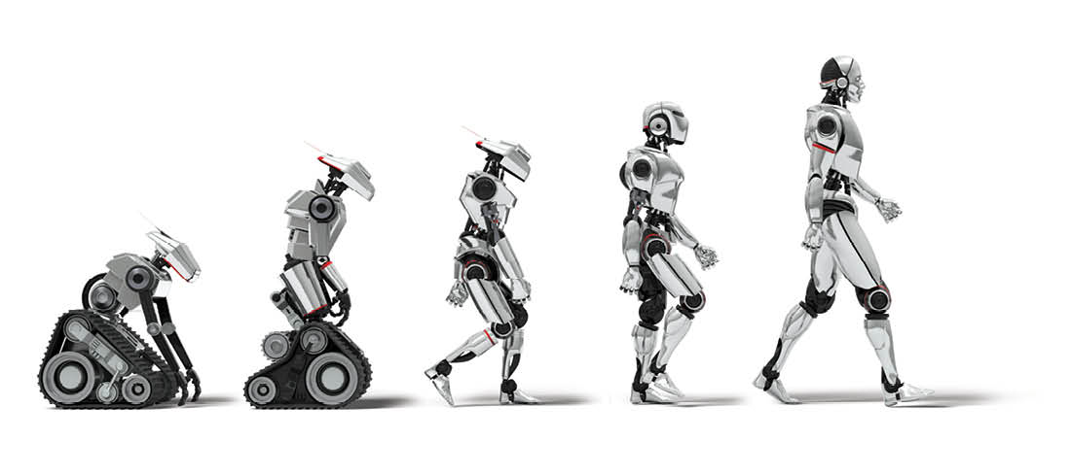
Extensions
Making your bot bigger, brighter, and better.

Slide 32
Extensions – let’s imagine!
Look at “Client” events
Look at properties, methods of “Guild”, “User”, “TextChannel”, “Message”

Slide 33
Security concerns
Things you’ve thought of
Permissions https://discordapi.com/permissions.html
What if someone gets the bot API token?
My official advice to you:
Host your own bots
Don’t use bots hosted by people you don’t know
Don’t give bots dangerous permissions
READ_MESSAGES? BAN_MEMBERS? ADMINISTRATOR?

Slide 34
Free time!
Some Suggestions if you’re not sure:
Edit message detection
Send detection-messages to another text channel
Delete last 20 messages
Delete messages with images
Send random images
Reset nicknames to usernames
Getting more ideas:
Node packages (Cleverbot, Youtube, Google, etc.)
Browse open source Discord bots

Slide 35
Thanks for coming!
Questions? Comments?

Slide 36
Appendix: Additional JS references
Javascript syntax
https://www.w3schools.com/js/default.asp
Javascript Callbacks
http://javascriptissexy.com/understand-javascript-callback-functions-and-use-them/
Node Event Loop
https://www.youtube.com/watch?v=8aGhZQkoFbQ
http://latentflip.com/loupe/

