Slide 1
Stem Cells in Life and Disease Immortality Inside You
Blair Benham-Pyle
Tyler Burns
Joe Ouadah
(Stanford Cancer Biology PhD Program)
Splash! Spring 2012

Slide 2
What do you think a stem cell is? (discuss with people around you)
A stem cell is one that can BOTH:
Self-Renew.
Differentiate into other kinds of cells.

Slide 3
Stem Cells Are Immortal
What makes a cell immortal?
Self-renewal: the ability to make copies of yourself.

Slide 4
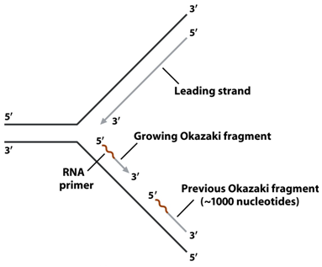
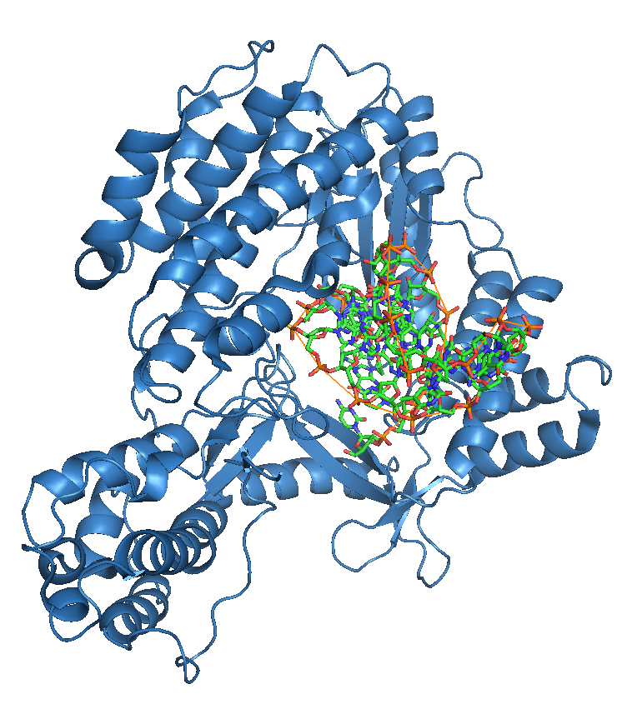
What else makes a cell immortal?
Unlimited Replication: the ability to divide forever.

Slide 5
Is there more than one type of stem cell? If so, how many?
YES! There are many types of stem cells, and we still haven’t even found them all…

Slide 6
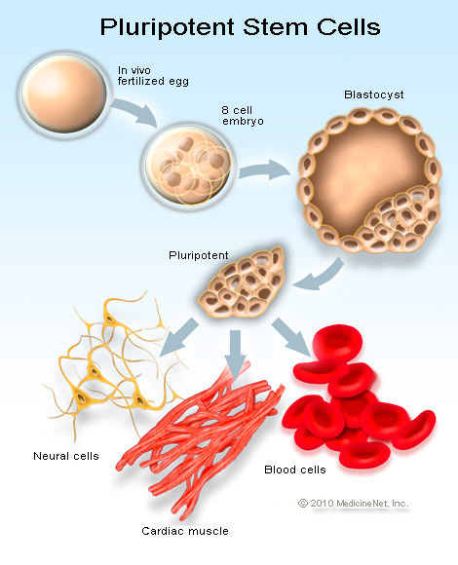
Embryonic Stem Cells
Embryonic stem cells are pluripotent stem cells first seen in the blastocyst that can give rise to the entire organism.
[http://homepages.wmich.edu/~dkane1/flipbook/Flipbook%20Movie.mov]

Slide 7
The “Lineage” Concept
Caenorhabditis Elegans

Slide 8
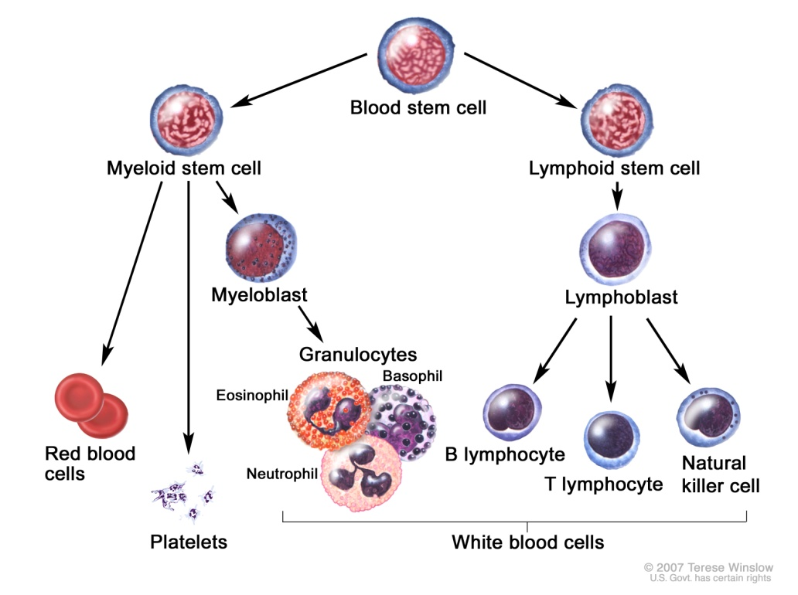
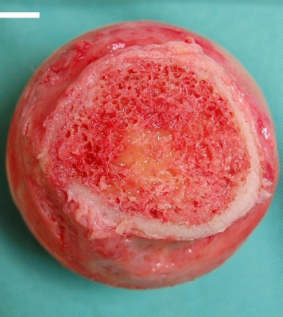
Adult Stem Cells in the Blood
Hematopoietic stem cells give rise to all red and white blood cells and platelets.
[http://www.youtube.com/watch?v=mUcE1Y_bOQE]

Slide 9
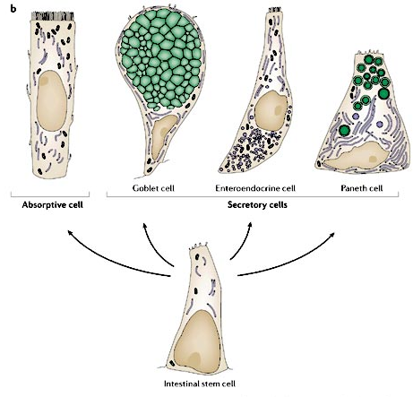
Adult Stem Cells in the Intestine
Intestinal stem cells maintain and repair intestinal tissue – they are the most rapidly dividing stem cells in the human body.
[http://www.youtube.com/watch?v=mUcE1Y_bOQE]

Slide 10
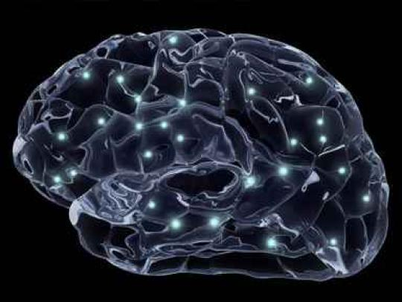
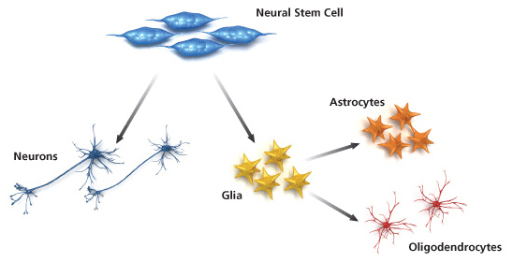
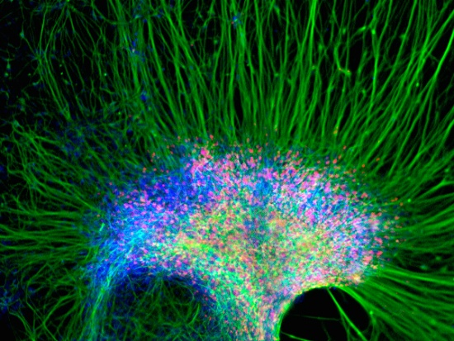
Adult Stem Cells in the Brain
Neural stem cells build neurons, which allow learning and memory, and glial cells in the brain and spinal cord.

Slide 11
Neural Stem Cells Serve Memory Functions

Slide 12
They Are Important in Olfaction (smell)

Slide 13
They Can be Influenced by Diet and Exercise

Slide 14
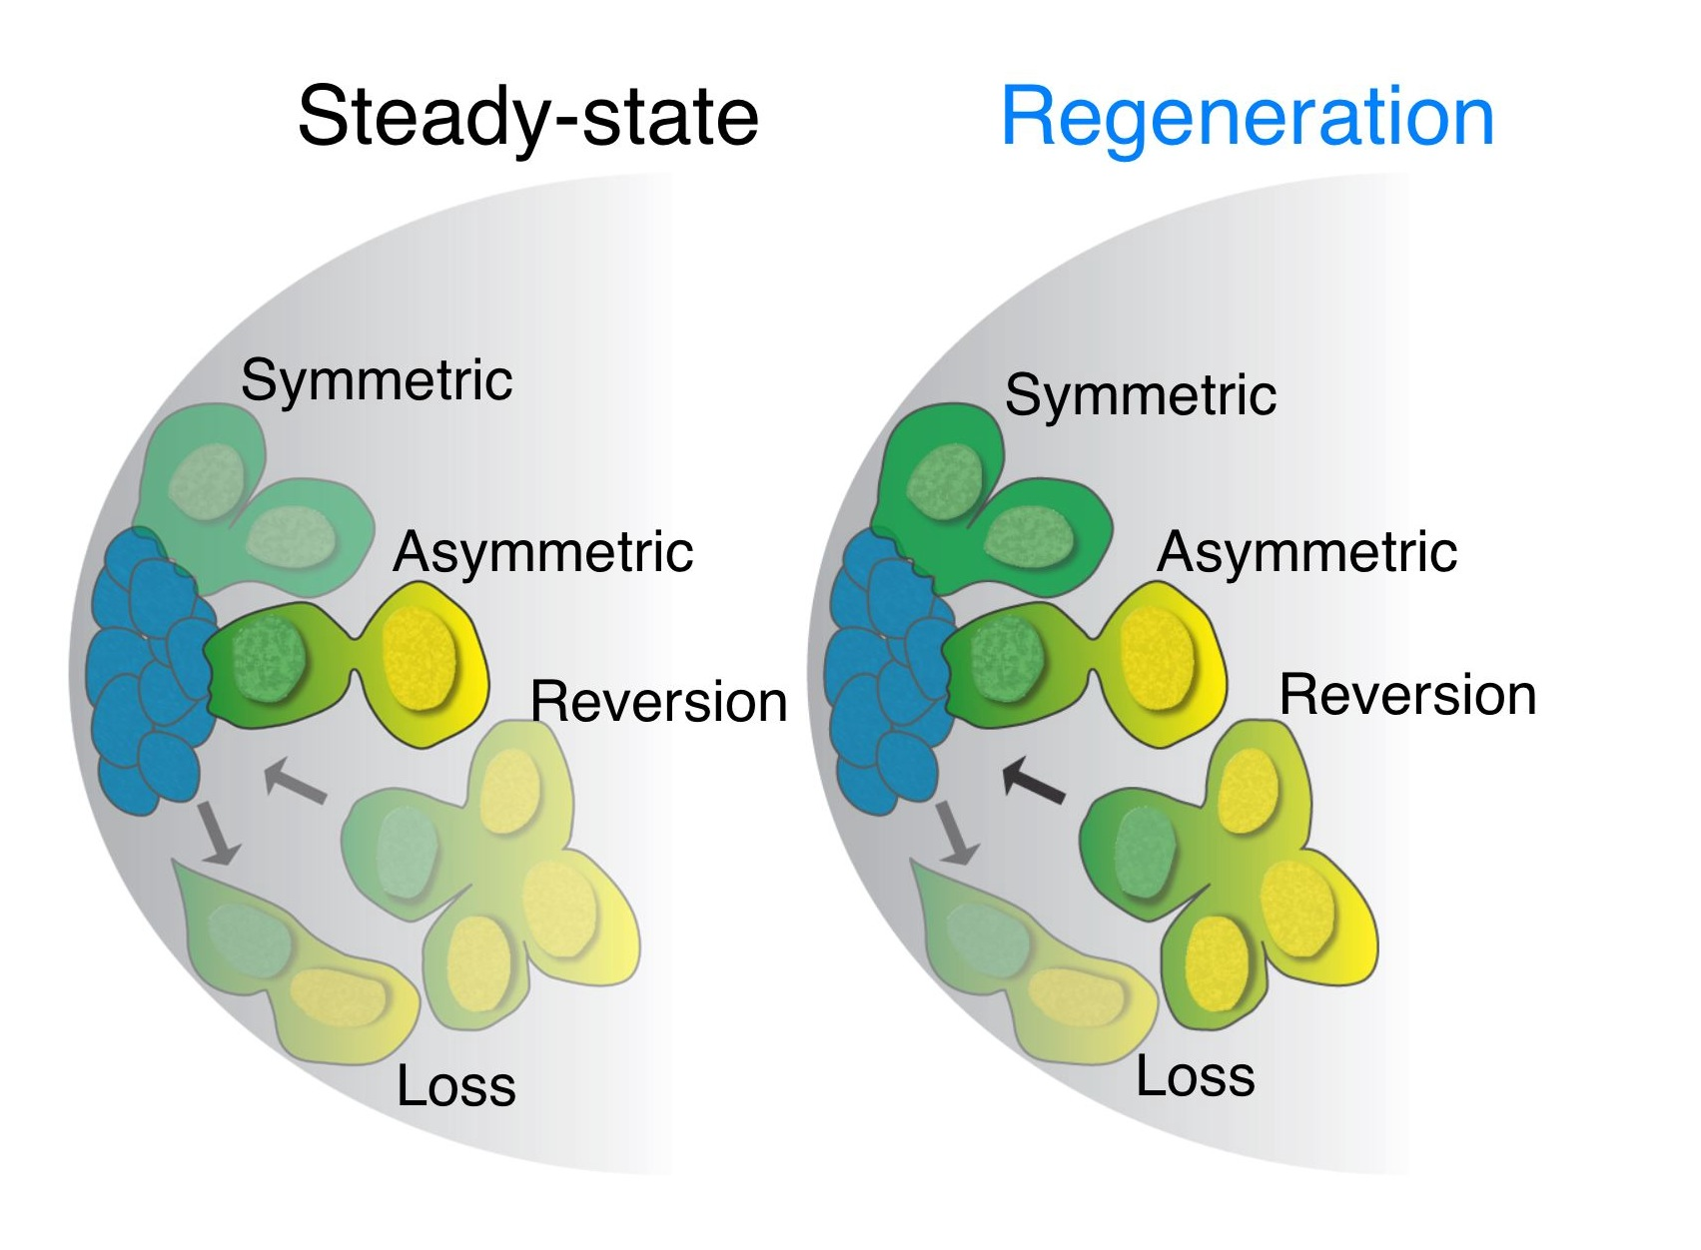
They Can Sometimes De- and Trans-differentiate
Drosophila Melanogaster
Mus Musculus

Slide 15
Degenerative Diseases Alzheimer’s disease Parkinson’s disease

Slide 16
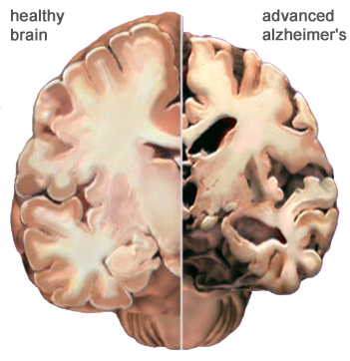
Alzheimer’s Disease

Slide 17
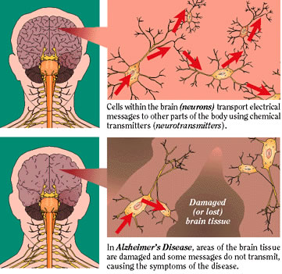
Symptoms

Slide 18
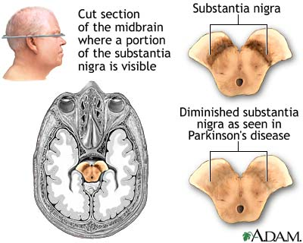
Parkinson’s Disease

Slide 19
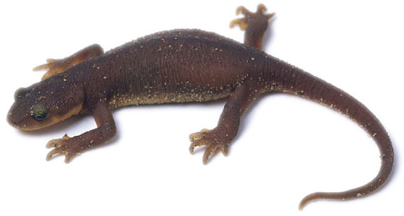
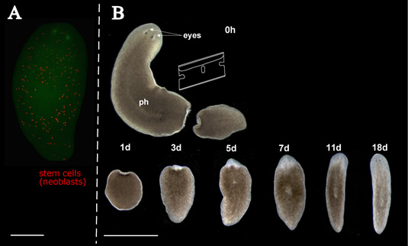
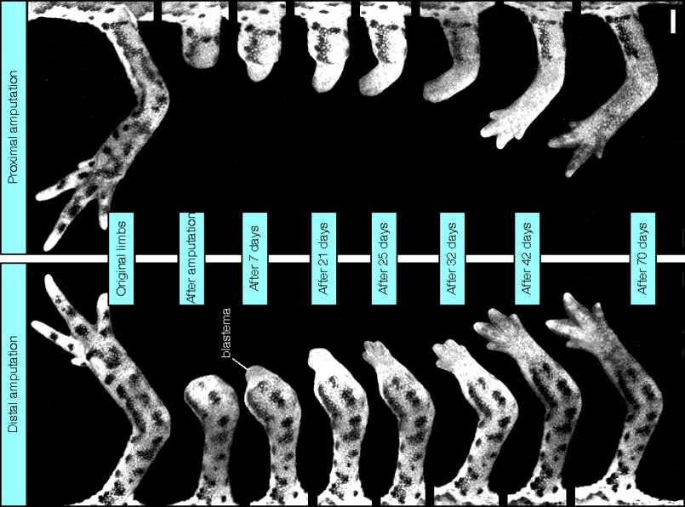
Regeneration: Non-Human Examples
Planaria (flatworms) can regrow their entire body! Someone even showed that 1/127 of a worm is sufficient to regrow the whole thing!
Newts (and salamanders) are vertebrates that can regrow whole limbs, tails, eyes, etc.

Slide 20
Humans can’t naturally regenerate as well as some animals can, so how would you design a regenerative therapy for degenerative diseases like Alzheimer’s and Parkinson’s?
Many scientists are working on stem cell therapies for this exact purpose.

Slide 21
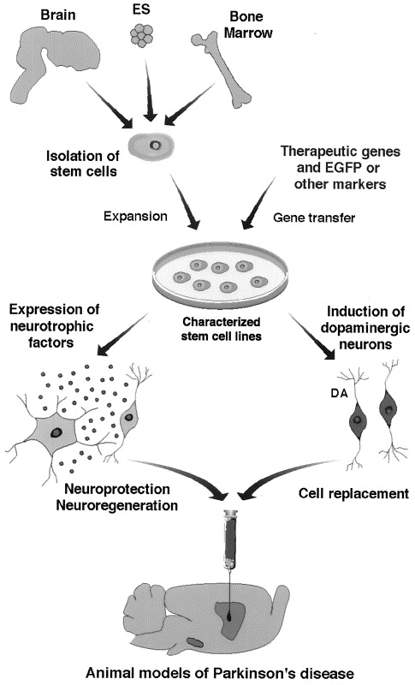
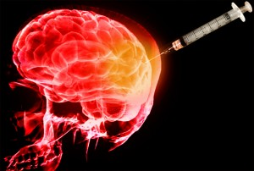
Treating Humans with Stem Cells

Slide 22
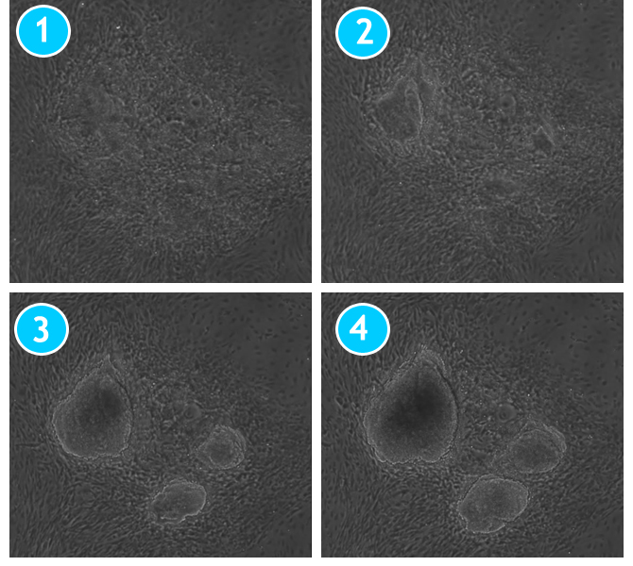
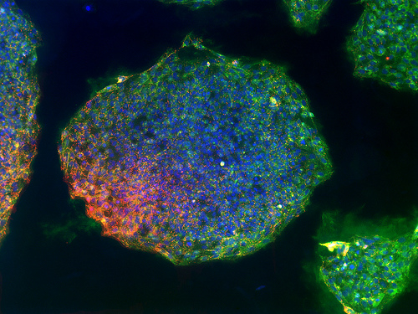
Induced Pluripotent Stem Cells (“iPS”)

Slide 23
How do you make them?

Slide 24
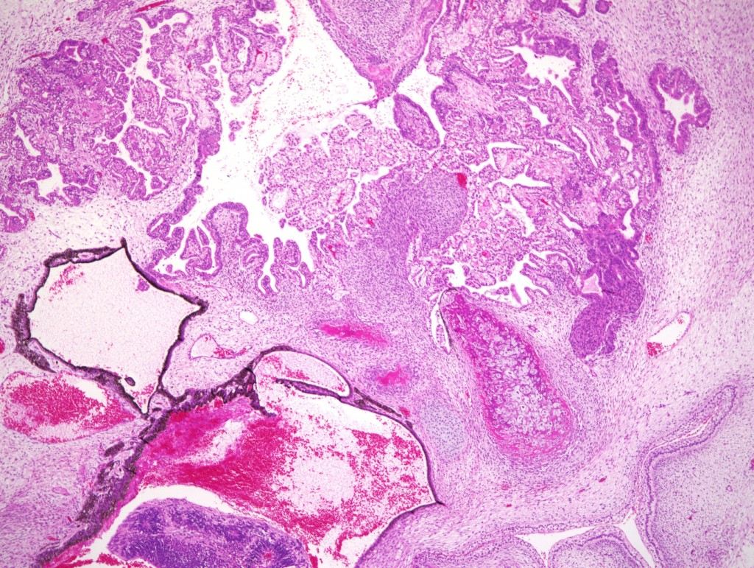
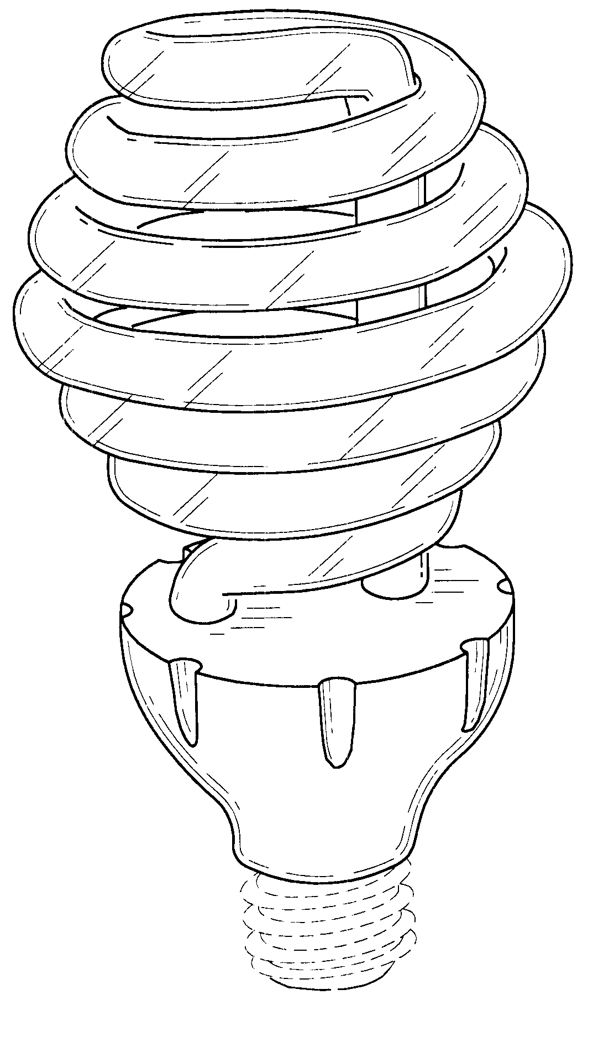
Problems with iPS

Slide 25
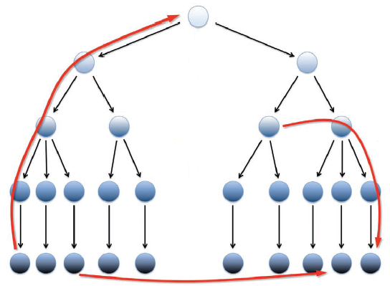
Direct Reprogramming
In addition to converting adult cells “back” into iPS, scientists can now also convert them directly into other cell types.
iPS route
normal route
direct route

Slide 26
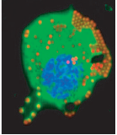
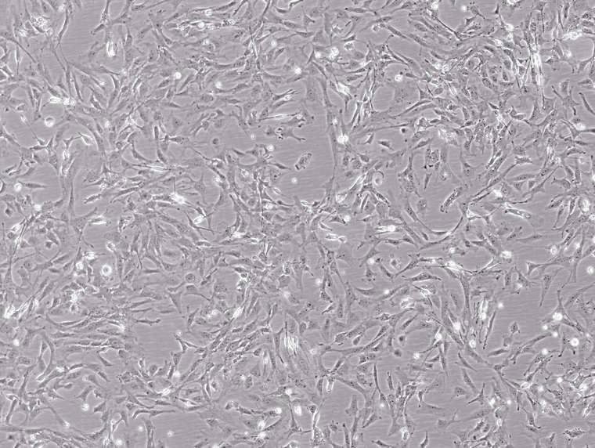
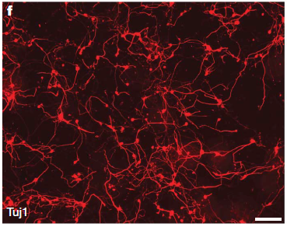
Examples of Direct Reprogramming
Cardiomyocytes
Macrophages
Fibroblasts
Neurons

Slide 27
Overproliferative Diseases Cancer

Slide 28
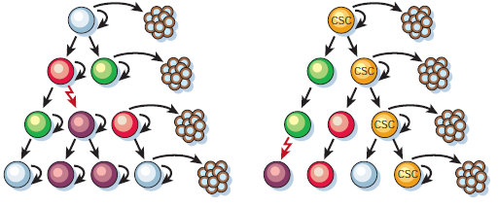
Stem Cells in Cancer
One major question in cancer therapy is, do cancers act like normal organs?

Slide 29
Finding Cancer Stem Cells
Surface Antigens – “flags” that cells express on their surface to identify themselves.
Transcription Factors – nuclear proteins that control what genes a cell expresses.
Why are they hard to find?
It is difficult to get human tumor samples.
Stem cells can be different in different tissues (especially in cancer) so it’s difficult to assign permanent CSC markers.
Cancer cells always have genetic mutations, so they can “choose” to follow some aspects of normal organogenesis and ignore others.

Slide 30
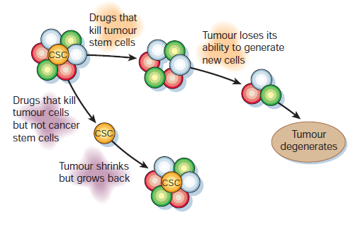
Why does the CSC model matter?
If cancers really do have their own stem cells, then we need to start designing smarter drugs to target them.

Slide 31
How would you design a drug that specifically targets cancer stem cells?
Antibodies that target CSC-specific markers can teach the immune system to consider those cells as an infection (immunotherapy).
Because stem cells tend to live in places with lots of blood vessels, anti-angiogenic drugs (like Avastin) might be good at targeting them.

Slide 32
Where is the stem cell field going?
Full genome sequencing now allows us to figure out entire gene networks that give stem cells their unique functions, as opposed to looking at one gene at a time.
Dedifferentiation and transdifferentiation have now been observed to occur naturally in both humans and other animals, so scientists are trying to figure out when, how, and why this happens.
Reprogramming (iPS or direct) tends to introduce mutations into the genome that can be damaging, so scientists are trying to find ways to reprogram cells less invasively for clinical use.
And much, much more…

Slide 33
The End! Questions? (about anything) Blair – blairb1@stanford.edu Tyler – tjburns@stanford.edu Joe – yzouadah@stanford.edu

