Slide 1
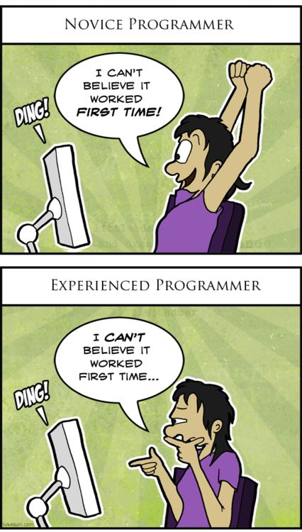
A Beginner’s Guide to the World of Programming
Stanford SPLASH
November 8-9, 2014
Instructors: Evan Boyle and Jessica Ribado

Slide 2
The Programming Toolbox
Statements
Basic unit of code
Single line of code that does something
Example: print “Hello world!”
Variables
Store information
Example: x = 17
Keywords
Term with a very specific meaning that cannot be used for anything else
Examples: print, import, export, etc.

Slide 3
Twitter
How does it work?
What information do tweets contain?
Why would Twitter data useful?
Where would you go to access Twitter data?
What if you needed to look through hundreds or thousands of tweets?

Slide 4
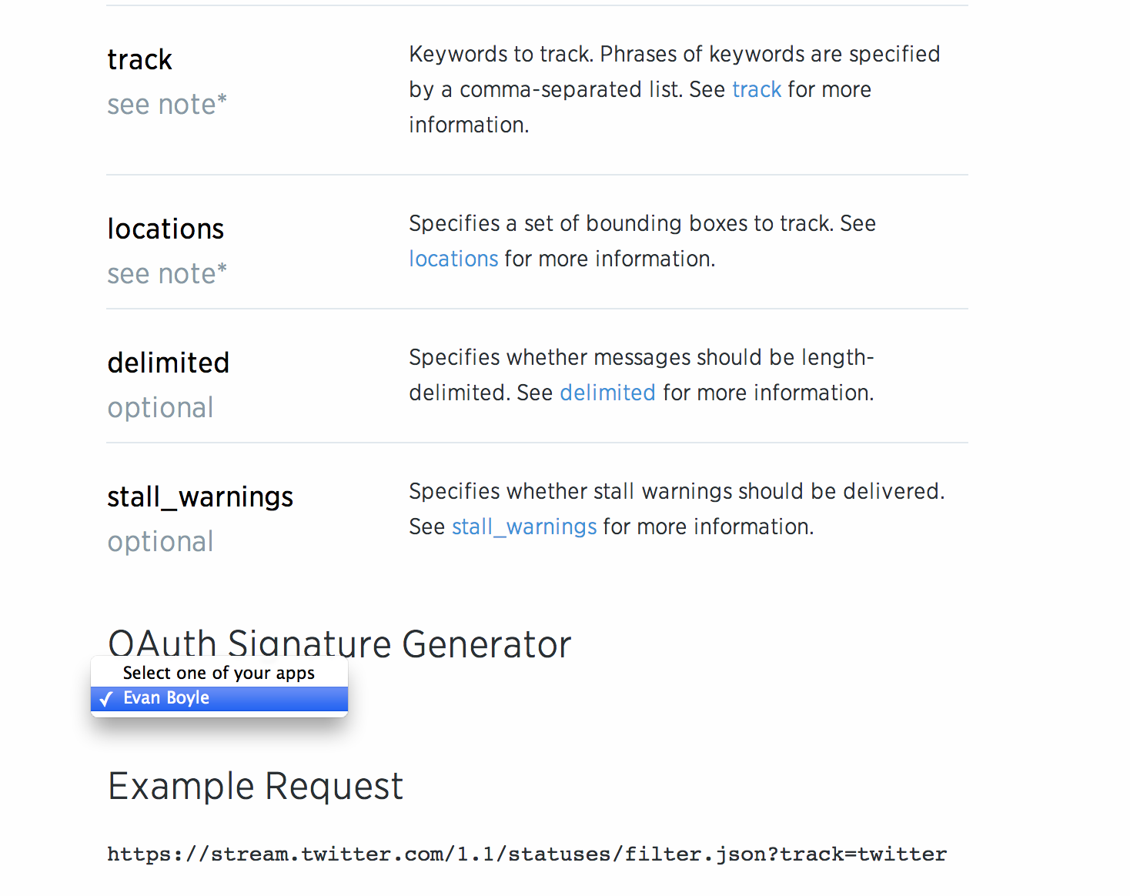
Twitter Streaming
https://dev.twitter.com/streaming/reference/post/statuses/filter

Slide 5
Twitter Query
Change the request query box to look for other characteristics.
“track=“ lets you search for keywords.

Slide 6
Twitter Streaming Command

Slide 7
Entering Twitter Stream
Paste the command you copied into a terminal window.
Then press enter.

Slide 8
Running Twitter Stream
Streaming is underway!

Slide 9
Stopping Twitter Stream
After several minutes (up to you!), hold control and press C to stop streaming
It’s happening in real time!

Slide 10
What do we have? Lots of text
The data is in a nested structure:
>text
>tweet content
>entities
>hashtags
>list of words tagged with ‘#’ in tweet
>urls
>links posted in the tweet
>retweeted
>whether or not the tweet is a ‘retweet,’ reposted from another user

Slide 11
Python
A simple scripting language
considered as a backend for most web applications
but has poor control over privacy
Uses classes, functions, data structures and variables to model environments or series of events
Don’t be afraid of new terms – things in Python tend to make intuitive sense

Slide 12
Learning Python
There are many resources online
Learn Python the Hard Way
http://learnpythonthehardway.org/book/
Codecademy
http://www.codecademy.com/tracks/python
Rosalind (learn by solving bioinformatics problems)
http://rosalind.info/problems/list-view/?location=python-village

Slide 13
Downloading Python

Slide 14
Typing code
There are many good options for saving and manipulating code (in my order of preference)
Sublime text (unlimited free trial available)
Notepad++
Xcode (Mac)
TextWrangler (Mac)
TextEdit (Mac)
Notepad (don’t use Notepad)

Slide 15
Python Reference
AFTER YOU LEARN THE BASICS, the Python library is a great way to review functions and learn new things about what Python can do

Slide 16
Working in Python

Slide 17
Parsing in Python
Python can run in a terminal interactively
Here I am parsing the nested Twitter structure using the json module

Slide 18
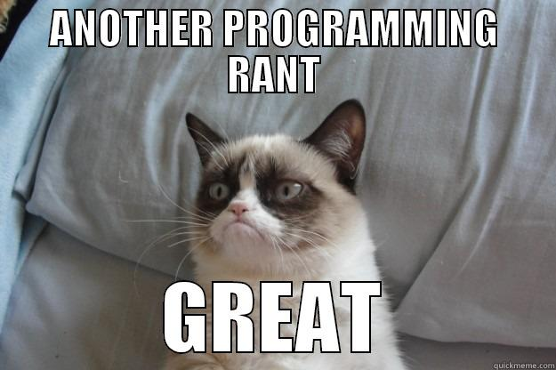
Errors in Python
Error message at the end of the file! What happened?

Slide 19
Counting in Python
Here I’m counting up the words in the tweets

Slide 20
Sorting in Python
Now I’m sorting by the word frequency and printing out the most common words
California?

Slide 21
Searching in Python

Slide 22
Real time news!

Slide 23
Hours later on Google News

Slide 24
Instagram
Pictures contain the same information as tweets
However, you can analyze your own data
This time – in R/R Studio

Slide 25
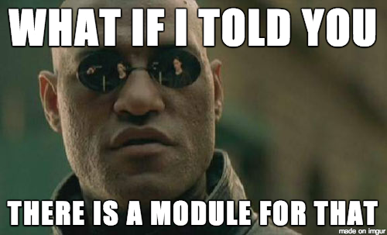
R/R Studio
A powerful language and environment for statistical computing and graphics
The main advantages of R are the fact that R is:
Freeware
There is a lot of help
available online.
Modules are written
by other people that
can easily be downloaded

Slide 26
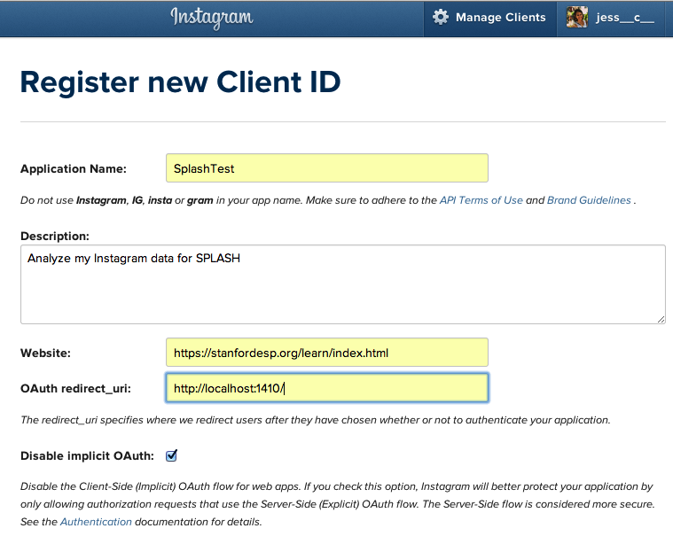
Authentication
To work with the Instagram API go to:
http://instagram.com/developer/
Click on “Register Your Application” and go through the login.

Slide 27
Authentication cont.

Slide 28
Search for user and download data

Slide 29
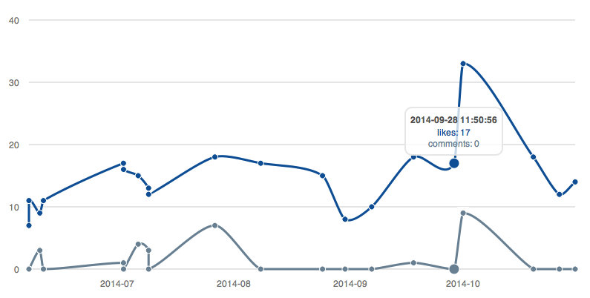
Visualizing your Instagram popularity
Conclusion: I am not very cool on Instagram

Slide 30
Java & C
Java is a more advanced language. It features:
extensive packages, or collections of code for specialized functions (usually web-based)
more privacy settings, which prevent variables from one user being accessed by another user
C is an older language. It features:
manual control over memory allocation
more efficient operations (programs run faster)
very limited built-in functionality

Slide 31
Learning Java
Java is harder to learn on your own without any background
Once you learn one language, like Python, it becomes easier to learn a second
And easier to learn a third!
There are many resources
https://www.udemy.com/java-tutorial
https://www.youtube.com/playlist?list=PLDAA5DE54FB5215EC

Slide 32
Learning C
C is simple, but difficult to learn because it’s so old
Most tutorials assume you are familiar with computer science since it is difficult to explain C functions without a background
There are again many resources
http://www.learn-c.org/
http://c.learncodethehardway.org/book/
http://www.cprogramming.com/tutorial/c-tutorial.html

Slide 33
MOOCs
Now there are multiple platforms for taking online courses for free
Coursera (Spinoff from Stanford faculty)
Edx (Harvard and MIT)
Stanford Online (Stanford)
Khan Academy (super-genious Salman Khan)
MIT Opencourseware (lectures from MIT)
Udacity (mostly not free!)

Slide 34
Coursera Courses (Explore!)

Slide 35
