Slide 1
Opening Statement
Every hour, the sun provides the earth with as much energy as all of human civilization uses in an entire year. With solar energy supplies near important population-dense regions, solar energy is easy to harvest in ways that best benefit humanity. With new technologies like Photon Enhanced Thermionic Emission causing efficiencies to skyrocket to 60% and economies of scale enabling solar technology to become significantly cheaper, solar power is now becoming cost-competitive with oil and has the potential to become highly lucrative for investors. Solar energy takes advantage of existing natural resources with minimal impact on the environment. Clean, cheap, and overwhelmingly abundant, solar is clearly the green energy technology of the future.

Slide 2
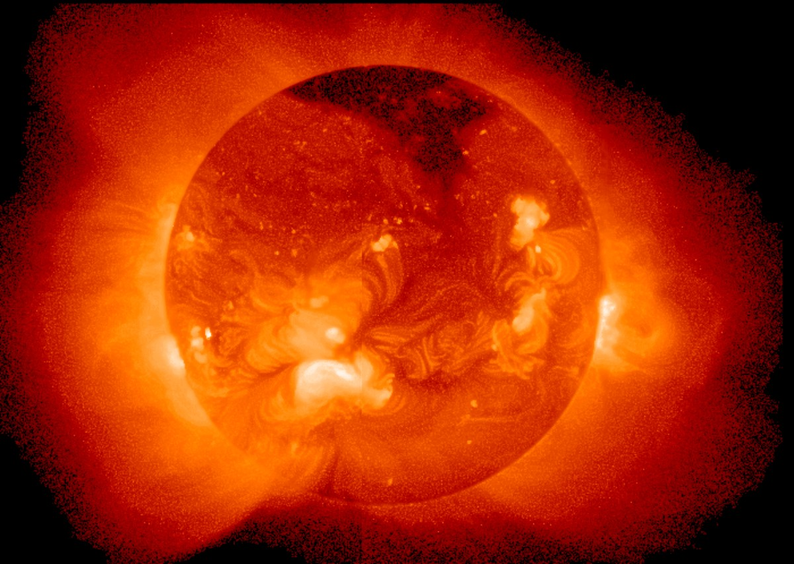
Solar Energy SMACKDOWN
Energy Availability / Location / Market

Slide 3
Global Energy Flux

Slide 4
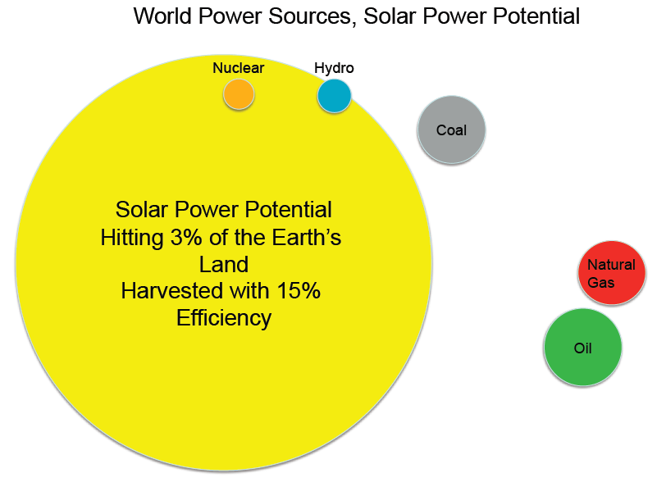
Credit: Professor Clemens

Slide 5
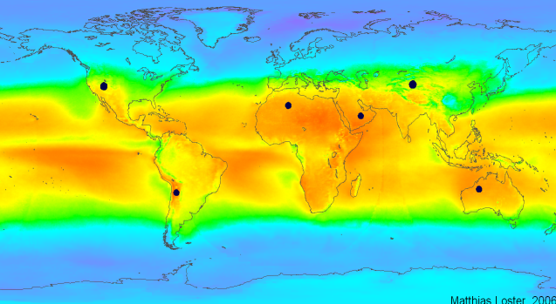
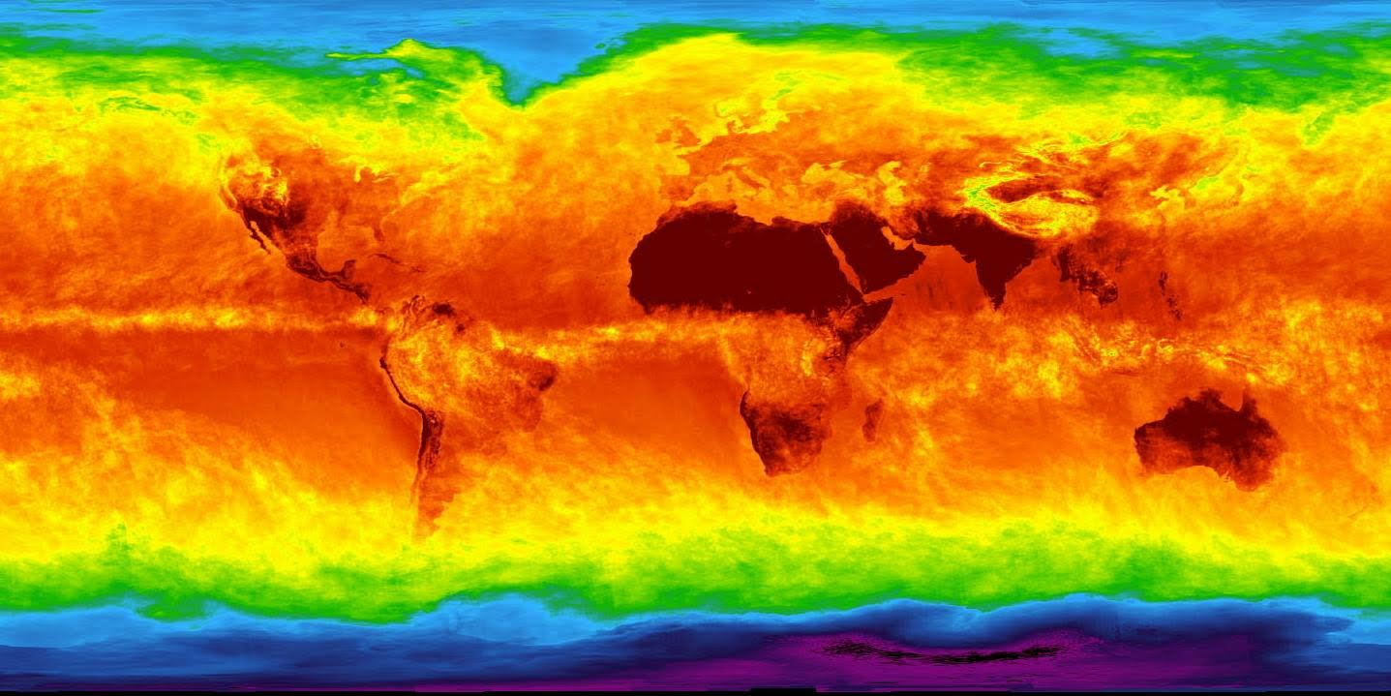
World Solar Energy Availability
solar
thermal

Slide 6
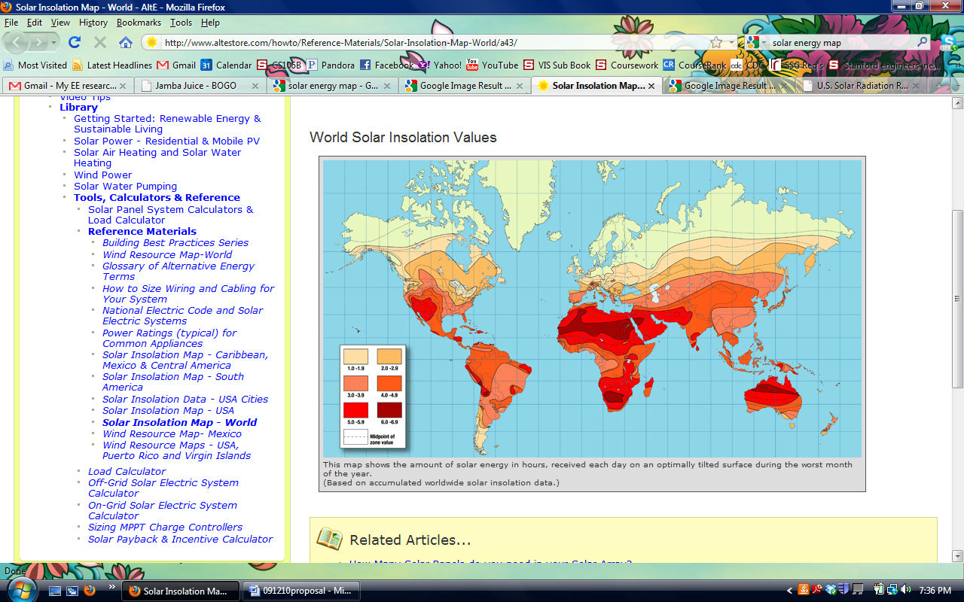
Even in the worst possible conditions, the American southwest does well.

Slide 7
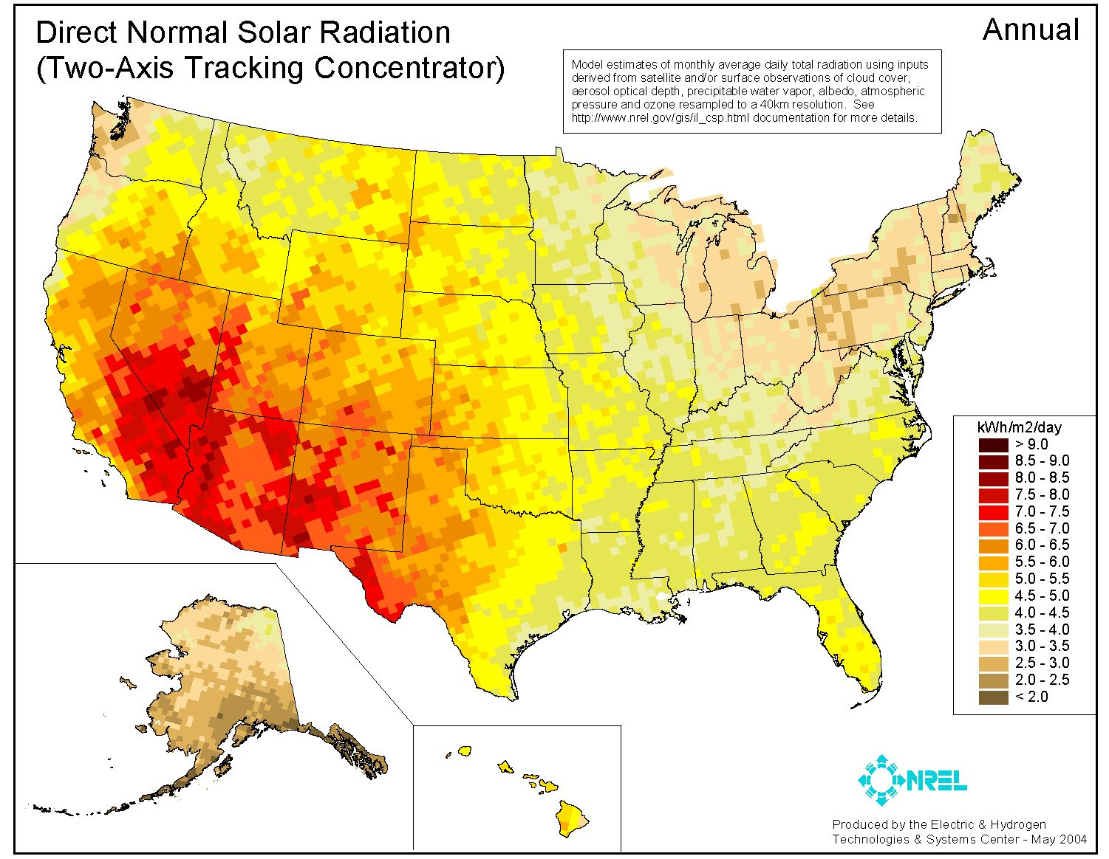
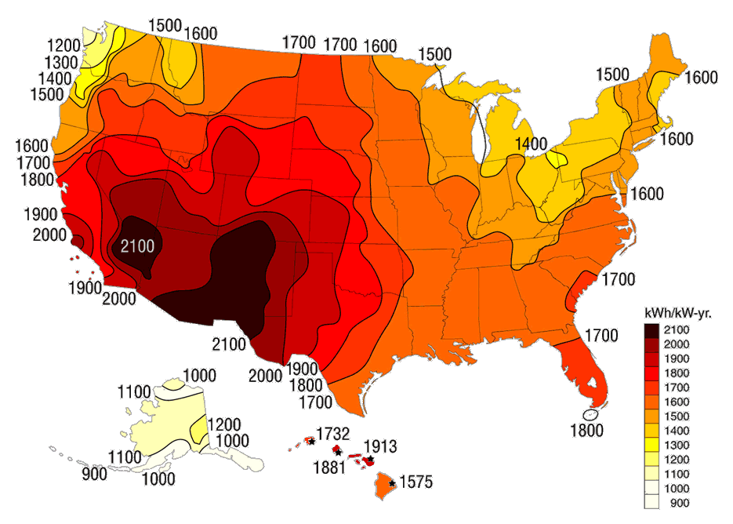
A Closer Look….

Slide 8
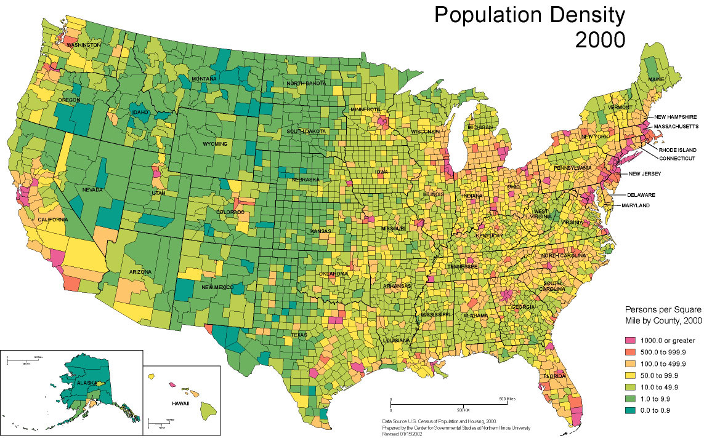
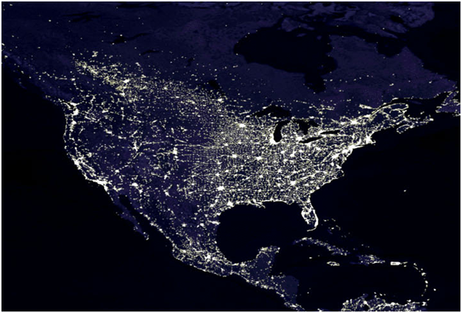
population
energy usage

Slide 10


Slide 11
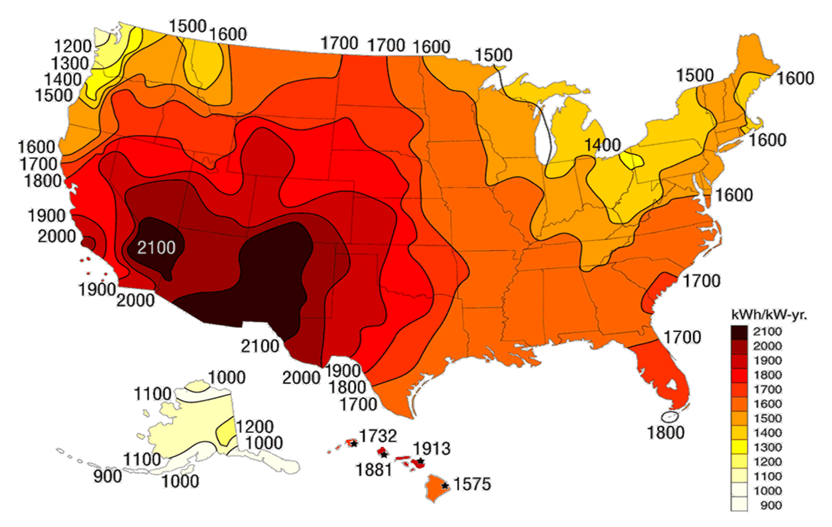

Slide 12
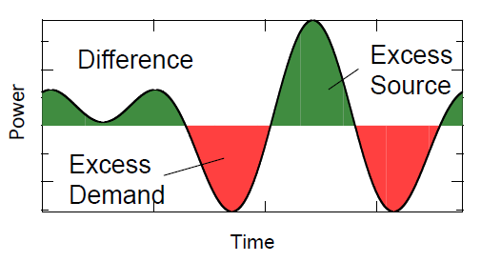
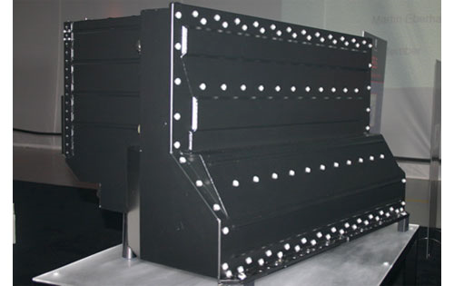

Preempting the opposition: yes, there’s an intermittency problem…
But there are solutions!
Battery systems
  Deep cycle, lead acid
  Lithium ion (like Tesla)
Smart energy grids (Recovery Act)
  Integrated so electricity can be dumped into the grid at peak production and harvested later
Storage for future use
  Hydrogen fuel cells
  Potential energy storage by pumping water

Slide 13

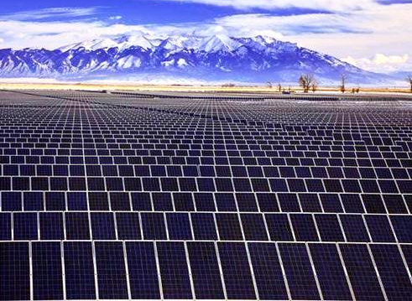
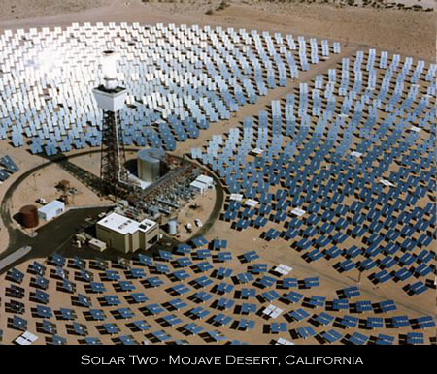
The market: any scale you want!
Large-scale utilities:
Organization of over 560
electric utilities using solar
investments
Major players joining the
solar ballgame: FPL
Energy, PG&E, SDG&E
and Southern California
Edison

Slide 14
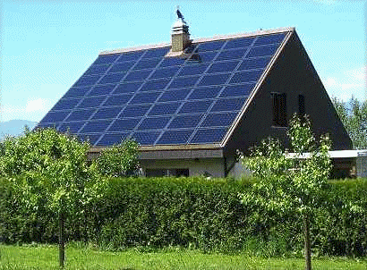
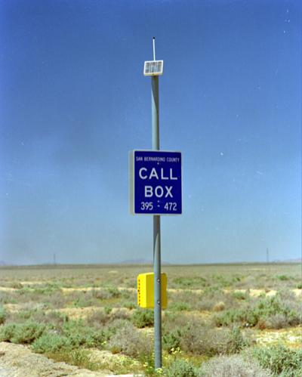


The market: any scale you want!
Household usage:
Massive federal subsidies
Easy installation, can be
plugged in in series

